Slide 1
Agile Approach and manifesto

Slide 2
Agile Approach
Agile is a term used to describe software development approaches that employ continual planning, learning, improvement, team collaboration, evolutionary development, and early delivery.
It encourages flexible responses to change.

Slide 3
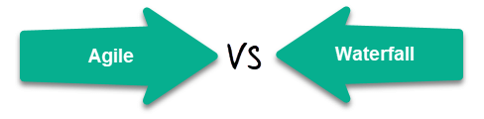
Waterfall vs Agile
Agile follows an incremental approach whereas the Waterfall is a sequential design process.
Agile performs testing concurrently with software development whereas in Waterfall methodology testing comes after the “Build” phase.
Agile allows changes in project development requirement whereas Waterfall has no scope of changing the requirements once the project development starts.

Slide 4
Waterfall vs Agile
Waterfall is a Liner Sequential Life Cycle Model whereas Agile is a continuous iteration of development and testing in the software development process.
Agile methodology is known for its flexibility whereas Waterfall is a structured software development methodology.

Slide 5
The Manifesto for Agile Software Development
“We are uncovering better ways of developing software by doing it and helping others do it. Through this work we have come to value:
Individuals and interactions over processes and tools
Working software over comprehensive documentation
Customer collaboration over contract negotiation
Responding to change over following a plan
That is, while there is value in the items on the right, we value the items on the left more.”

Slide 6
What is Agility?
Effective (rapid and adaptive) response to change (team members, new technology, requirements)
Effective communication in structure and attitudes among all team members, technological and business people, software engineers and managers.
Drawing the customer into the team. Eliminate “us and them” attitude. Planning in an uncertain world has its limits and plan must be flexible.
Organizing a team so that it is in control of the work performed.
Emphasize an incremental delivery strategy.

Slide 7
What is Agility?....
Yielding …
Rapid, incremental delivery of software
The development guidelines stress delivery over analysis and design although these activates are not discouraged, and active and continuous communication between developers and customers.

Slide 8
Why and What Steps are Agility important?
Why?
The modern business environment is fast-paced and ever-changing. It represents a reasonable alternative to conventional software engineering for certain classes of software projects. It has been demonstrated to deliver successful systems quickly.
What?
May be termed as “software engineering lite” The basic activities- communication, planning, modelling, construction and deployment remain. But they morph into a minimal task set that push the team toward construction and delivery sooner.
The only really important work product is an operational “software increment” that is delivered.

Slide 9
Agility and the Cost of Change
Conventional wisdom :
The cost of change increases nonlinearly as a project progresses.
It is relatively easy to accommodate a change when a team is gathering requirements early in a project.
If there are any changes, the costs of doing this work are minimal.
But if the middle of validation testing, a stakeholder is requesting a major functional change.
Then the change requires a modification to the architectural design, construction of new components, changes to other existing components, new testing and so on.
Costs escalate quickly.

Slide 10
Agility and the Cost of Change
A well-designed agile process may “flatten” the cost of change curve by coupling incremental delivery with agile practices such as continuous unit testing and pair programming.
Thus team can accommodate changes late in the software project without dramatic cost and time impact.

Slide 11
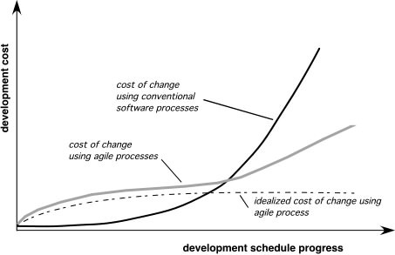
Agility and the Cost of Change

Slide 12
An Agile Process
Is driven by customer descriptions of what is required.
Some assumptions:
Recognizes that plans are short-lived (some requirements will persist, some will change. Customer priorities will change)
Develops software iteratively with a heavy emphasis on construction activities (design and construction are interleaved, hard to say how much design is necessary before construction. Design models are proven as they are created. )
Analysis, design, construction and testing are not predictable.
Thus has to Adapt as changes occur due to unpredictability.
Delivers multiple ‘software increments’, deliver an operational prototype or portion of an OS to collect customer feedback for adaption.

Slide 13
Agility Principles
Our highest priority is to satisfy the customer through early and continuous delivery of valuable software.
Welcome changing requirements, even late in development. Agile processes harness change for the customer's competitive advantage.
Deliver working software frequently, from a couple of weeks to a couple of months, with a preference to the shorter timescale.
Business people and developers must work together daily throughout the project.
Build projects around motivated individuals. Give them the environment and support they need, and trust them to get the job done.
The most efficient and effective method of conveying information to and within a development team is face–to–face conversation.

Slide 14
Agility Principles
Working software is the primary measure of progress.
Agile processes promote sustainable development. The sponsors, developers, and users should be able to maintain a constant pace indefinitely.
Continuous attention to technical excellence and good design enhances agility.
Simplicity – the art of maximizing the amount of work not done – is essential.
The best architectures, requirements, and designs emerge from self–organizing teams.
At regular intervals, the team reflects on how to become more effective, then tunes and adjusts its behavior accordingly.

Slide 15
Extreme Programming(XP)
One of the most widely used agile process, originally proposed by Kent Beck in 2004. It uses an object-oriented approach.
The key XP activities are :
XP Planning
XP Design
XP Coding
XP Testing
XP Planning
Begins with the listening, leads to creation of “user stories” that describes required output, features, and functionality. Customer assigns a value(i.e., a priority) to each story.
Agile team assesses each story and assigns a cost (development weeks. If more than 3 weeks, customer asked to split into smaller stories)
Working together, stories are grouped for a deliverable increment next release.

Slide 16
Extreme Programming(XP)...
A commitment (stories to be included, delivery date and other project matters) is made.
Three ways:
1. All stories will be implemented in a few weeks
2. High priority stories first
3. the riskiest stories will be implemented first.
After the first increment “project velocity”, namely number of stories implemented during the first release is used to help define subsequent delivery dates for other increments.
Customers can add stories, delete existing stories, change values of an existing story, split stories as development work proceeds.

Slide 17
Extreme Programming(XP)
XP Design ( occurs both before and after coding as refactoring is encouraged)
Follows the KIS principle (keep it simple) Nothing more nothing less than the story.
Encourage the use of CRC (class-responsibility-collaborator) cards in an object-oriented context. The only design work product of XP.
They identify and organize the classes that are relevant to the current software increment.
For difficult design problems, suggests the creation of “spike solutions”—a design prototype for that portion is implemented and evaluated.
Encourages “refactoring”—an iterative refinement of the internal program design. Does not alter the external behaviour yet improve the internal structure. Minimize chances of bugs. More efficient, easy to read.

Slide 18
Extreme Programming(XP)
XP Coding
Recommends the construction of a unit test for a story before coding commences. So implementer can focus on what must be implemented to pass the test.
Encourages “pair programming”. Two people work together at one workstation. Real time problem solving, real time review for quality assurance. Take slightly different roles.
XP Testing
All unit tests are executed daily and ideally should be automated. Regression tests are conducted to test current and previous components.
“Acceptance tests” (Customer Test) are defined by the customer and executed to assess customer visible functionality

Slide 19
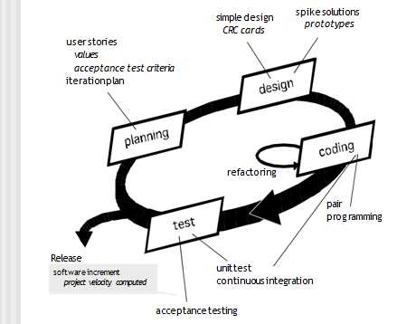
Extreme Programming(XP)

Slide 20
Scrum
A software development method Originally proposed by Schwaber and Beedle (an activity occurs during a rugby match) in early 1990.
Scrum principles are consistent with the agile manifesto and are used to guide development activities within a process that incorporates the following framework activities:
requirements
analysis
design
evolution
delivery.
Within each framework activity, work tasks occur within a process pattern called a sprint.

Slide 21
Scrum.....
Scrum—distinguishing features
Testing and documentation are on-going as the product is constructed.
Backlog—a prioritized list of project requirements or features that provide business value for the customer.
Items can be added to the backlog at any time (this is how changes are introduced).
The product manager assesses the backlog and updates priorities as required

Slide 22
Scrum.....
Work units occurs in “sprints” and is derived from a “backlog” of existing changing prioritized requirements.
Changes are not introduced in sprints (short term but stable) but in backlog.

Slide 23
Scrum....
Scrum meetings : Meetings are very short (15 minutes daily) and sometimes conducted without chairs .
Three key questions are asked and answered by all team members
what did you do since last meeting?
What obstacles are you encountering?
What do you plan to accomplish by next meeting?
A team leader, called a Scrum master, leads the meeting and assesses the responses from each person.
The Scrum meeting helps the team to uncover potential problems as early as possible .
Demos—deliver the software increment to the customer .
“demos” are delivered to the customer with the time-box allocated. May not contain all functionalities. So customers can evaluate and give feedbacks.

